Slide 1






.
|| JAI SRI GURUDEV || SRI ADICHUNCHANAGIRI SHIKSHANA TRUST ® SJB INSTITUTE OF TECHNOLOGY ( AFFILIATED TO VTU, BELAGAVI, ACCREDITED BY NAAC WITH “A” GRADE AND APPROVED BY AICTE –NEW DELHI) NO. 67, BGS HEALTH & EDUCATION CITY, DR. VISHNUVARDHAN ROAD, KENGERI, BENGALURU - 560060
Department of Computer Science & Engineering
Project
on
“ PRODUCT DEMAND FORCASTING”
Batch number:1
Guided by
Dr. KRISHNA A.N
Professor & Head
Dept. of CSE, SJBIT
Project Coordinator
Dr. Bindiya M K
Associate Professor
Dept. of CSE,SJBIT
Presentation By
JEEVAN D (1JB20CS404)
K NIKHIL (1JB20CS405)
KARTHIK S .C (1JB20CS406)
VINAYAK G BHOVI (1JB20CS415)

Slide 2

ABSTRACT
Supply chain control is crucial for business success, and accurate customer demand prediction is a key factor in effective supply chain management.
This article proposes a new method that utilizes machine learning techniques to improve the accuracy of demand prediction.
The method involves collecting and analyzing historical store data, extracting relevant information, and applying various algorithms such as K-Nearest Neighbor, Support Vector Machine, Gaussian Naive Bayes, Random Forest, Decision Tree Classifier, and regressions.

Slide 3
INTRODUCTION
Organizations need to analyze their day-to-day sales information in order to forecast the sales of their products and services.
This forecasting can be used to increase the production of products to meet the demand or can be used to take corrective measures to increase the sales.
This project presents a method of sales forecasting using data science technique called Naive Bayesian classifier.
System build as real time application which is useful for manufacturing firms.

Slide 4
LITERATURE SURVEY
S.NO | TITLE | AUTHOR/ PUBLICATION YEAR | METHODOLOGY
1 | Forecasting new product demand using machine learning | P S Smirnov and V A Sudakov (2021) | It was implemented using : Gradient Tree Boosting for Regression
2 | Product Demand Forecasting with Machine Learning for Shop | Ariful Islam Arif , Saiful Islam Sany , Faiza Islam Nahin and AKM Shahariar Azad Rabby(2019) | It was implemented using KNN and Gaussian Nave Bayes .

Slide 5
LITERATURE SURVEY
S.NO | TITLE | AUTHOR/ PUBLICATION YAER | METHODOLOGY
3 | Forecasting demand profiles of new products | R.M. van Steenbergen (2020) | combine K-means, Random Forest, and Quantile Regression Forest algorithms to generate a forecast for the demand of a new product.
4 | Hierarchical Demand Forecasting for Factory Production of Perishable Goods | Can Chen, Yijun Wang, Guoan Huang, Hui Xiong | Time Series Demand Pattern, nonlinear autoregressive network with exogenous inputs (NARX)

Slide 6
AIM AND SCOPE
Proposed system is an real time application.
Proposed system makes use of ML technique called “naive bayesian classifer” for sales forecasting.
Proposed system is an automation for sales forecasting.
Its a browser based application and accessed by companies to the know the demand for the new products.

Slide 7
LIMITATIONS OF EXISTING SYSTEM
Time Consuming
Needs Experience
Needs Experts
Manual advising may not be accurate
Less Efficient

Slide 8
OBJECTIVES
Proposed system is an automation for sales forecasting.
Proposed system is meant for an specific organization.
Proposed system predicts sales for current products based on the similar products sales data.
Proposed system makes use of ML technique called “naive bayesian classifer” for sales forecasting.
Proposed system increase the business profit.
Proposed system speeds up the process of decision making.
Proposed system increases organizational control.

Slide 9
METHODOLOGY
Login Process for Admin and Company
Verification
Data Collection
Data Pre-Processing
Model Building

Slide 10
METHODOLOGY
Supervised Learning Technique
Its a predictive model used for the tasks where it involves prediction of one value using other values in the data-set. Supervised learning will have predefined labels. It classifies an object based on the parameters to one of the predefined set of labels.
Depending of the requirement, labels, parameters and data-set we select the appropriate algorithm for predictions. Algorithm is used to build a model that makes predictions based on evidence in the presence of uncertainty.
In this project For prediction we make use to “naive bayes algorithm” which is an efficient and works fine for all different sets of parameters. It also generates accurate results.

Slide 11
NAIVE BAYES ALGORITHM
Step 1: Scan the dataset (storage servers)
Step 2: Calculate the probability of each attribute value. [n, n_c, m, p]
Step 3: Apply the formulae
P(attributevalue(ai)/subjectvaluevj)=(n_c + mp)/(n+m)
Where:
n = the number of training examples for which v = vj
nc = number of examples for which v = vj and a = ai
p = a priori estimate for P(ai/vj)
m = the equivalent sample size
Step 4: Multiply the probabilities by p
Step 5: Compare the values and classify the attribute values to one of the predefined set of class.

Slide 12
PROCESS OF THE PROJECT
1.Administrator
The one who maintains the whole application and has full authority.
2.Member/Company
Member is a registered user.
Member makes use of the application services.
Member in a company which uses the application to know the demand for their products.
3.Guest
Guest is a person who has limited accessibility to the application.
Guest can view only the basic information related to the application.

Slide 13
ADMIN MODULES
Login Module
Company Verification
View Existing Companies
Company Queries
Logout

Slide 14
COMPANY MODULES
Registration Module
Login Module
Training Data-sets
Add Parameters
Sales Forecasting Module [New Product – Demand Prediction Module]

Slide 15
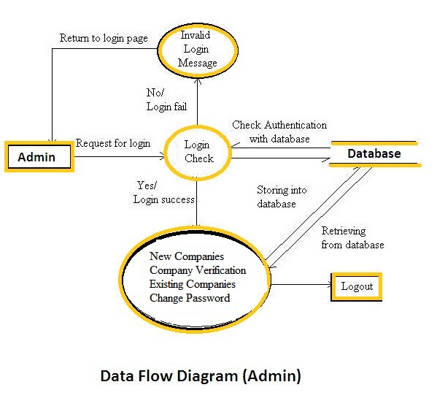
DATA FLOW DIAGRAM ‘ADMIN’

Slide 16
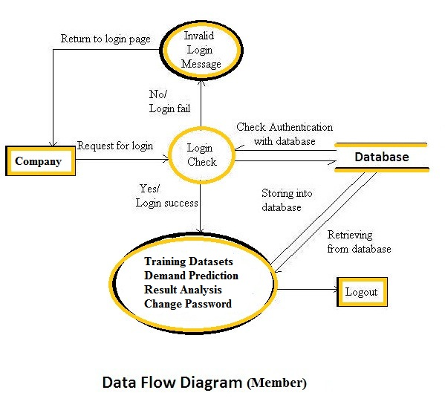
DATA FLOW DIAGRAM ‘COMPANY’

Slide 17
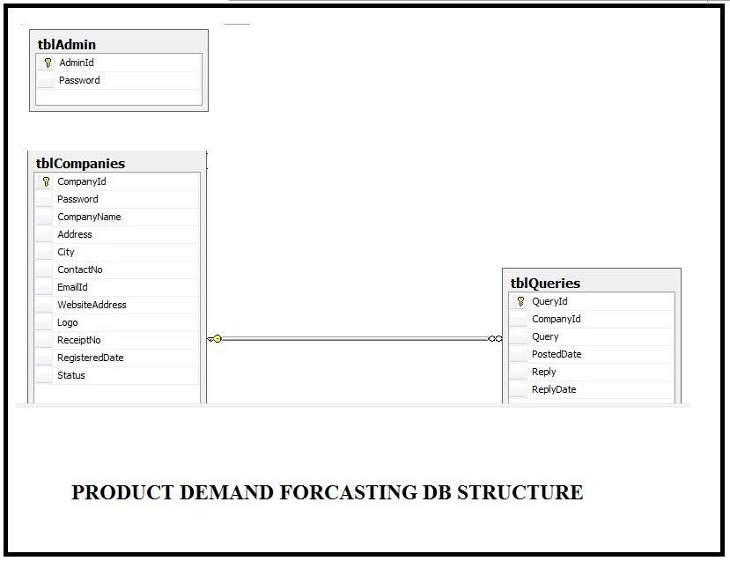
DB STRUCTURE

Slide 18
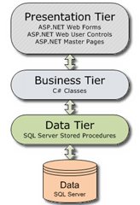
3 tier Architecture
It contains 3 main layers:
1.Data Layer
2.Business Logic Layer
3.Presentation Layer

Slide 19
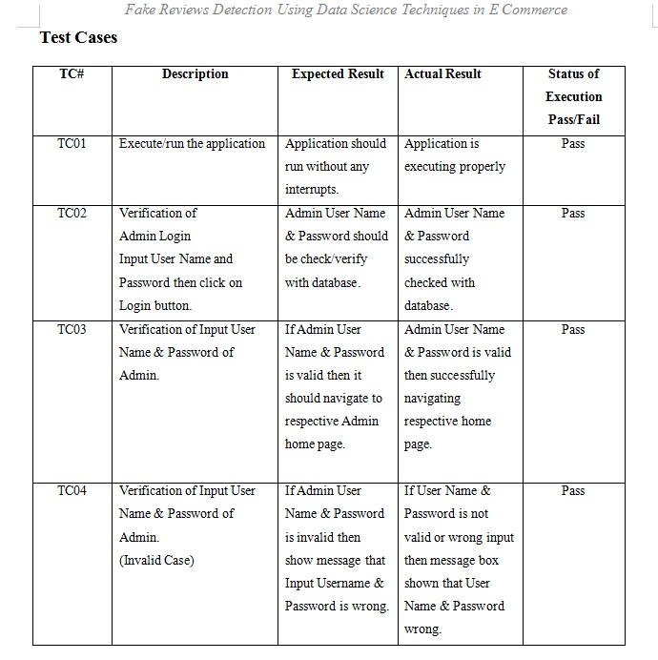
TESTCASES

Slide 20
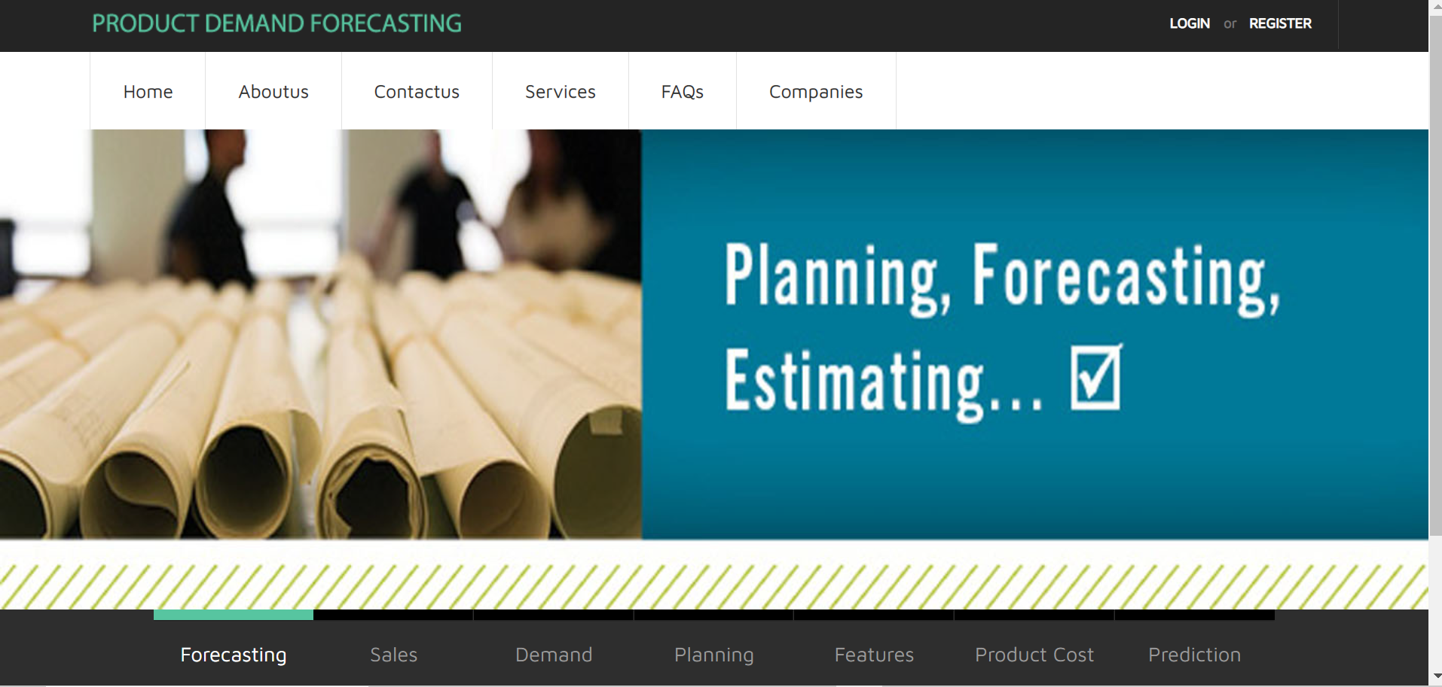
SNAPSHOTS
Fig.: Visitor - Home Page

Slide 21
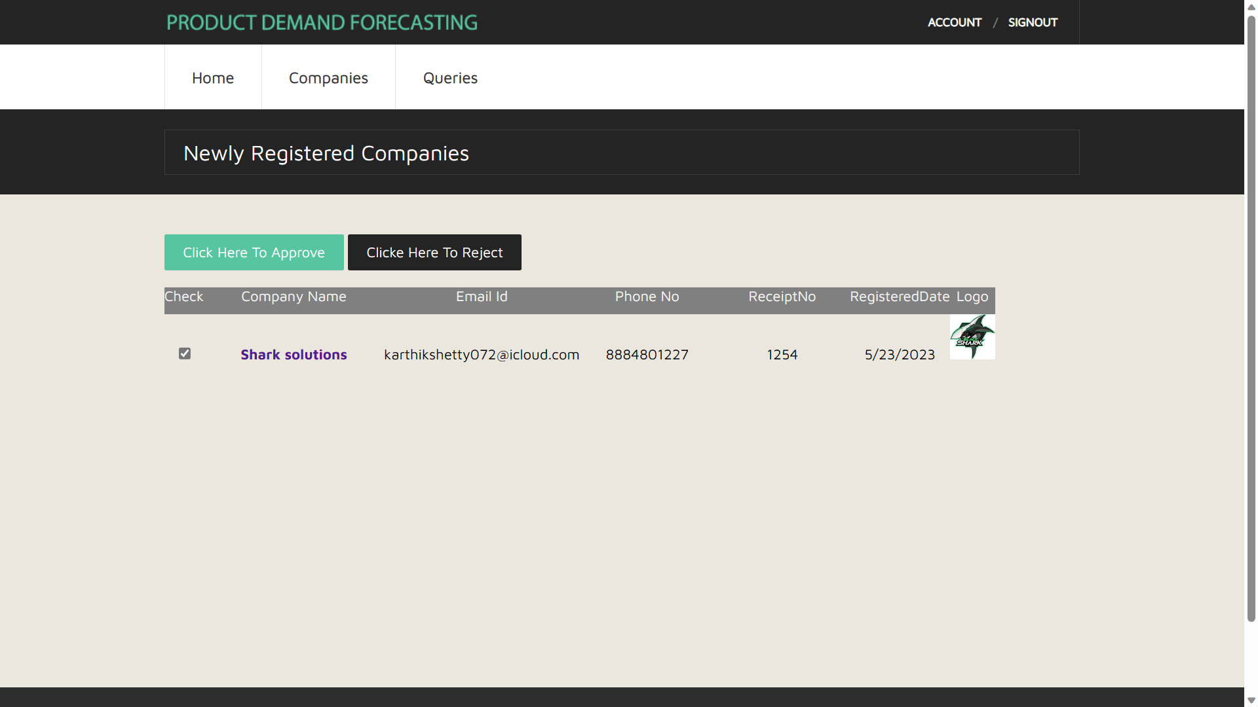
SNAPSHOT
Fig.: Admin home page , company approval or rejection

Slide 22
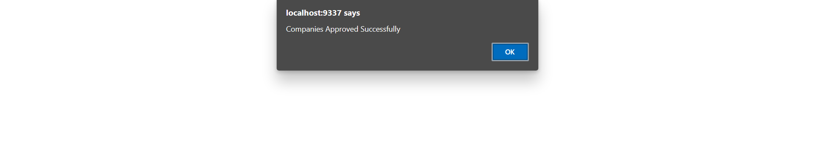
SNAPSHOT
Fig.: Admin Approved the company successfully

Slide 23
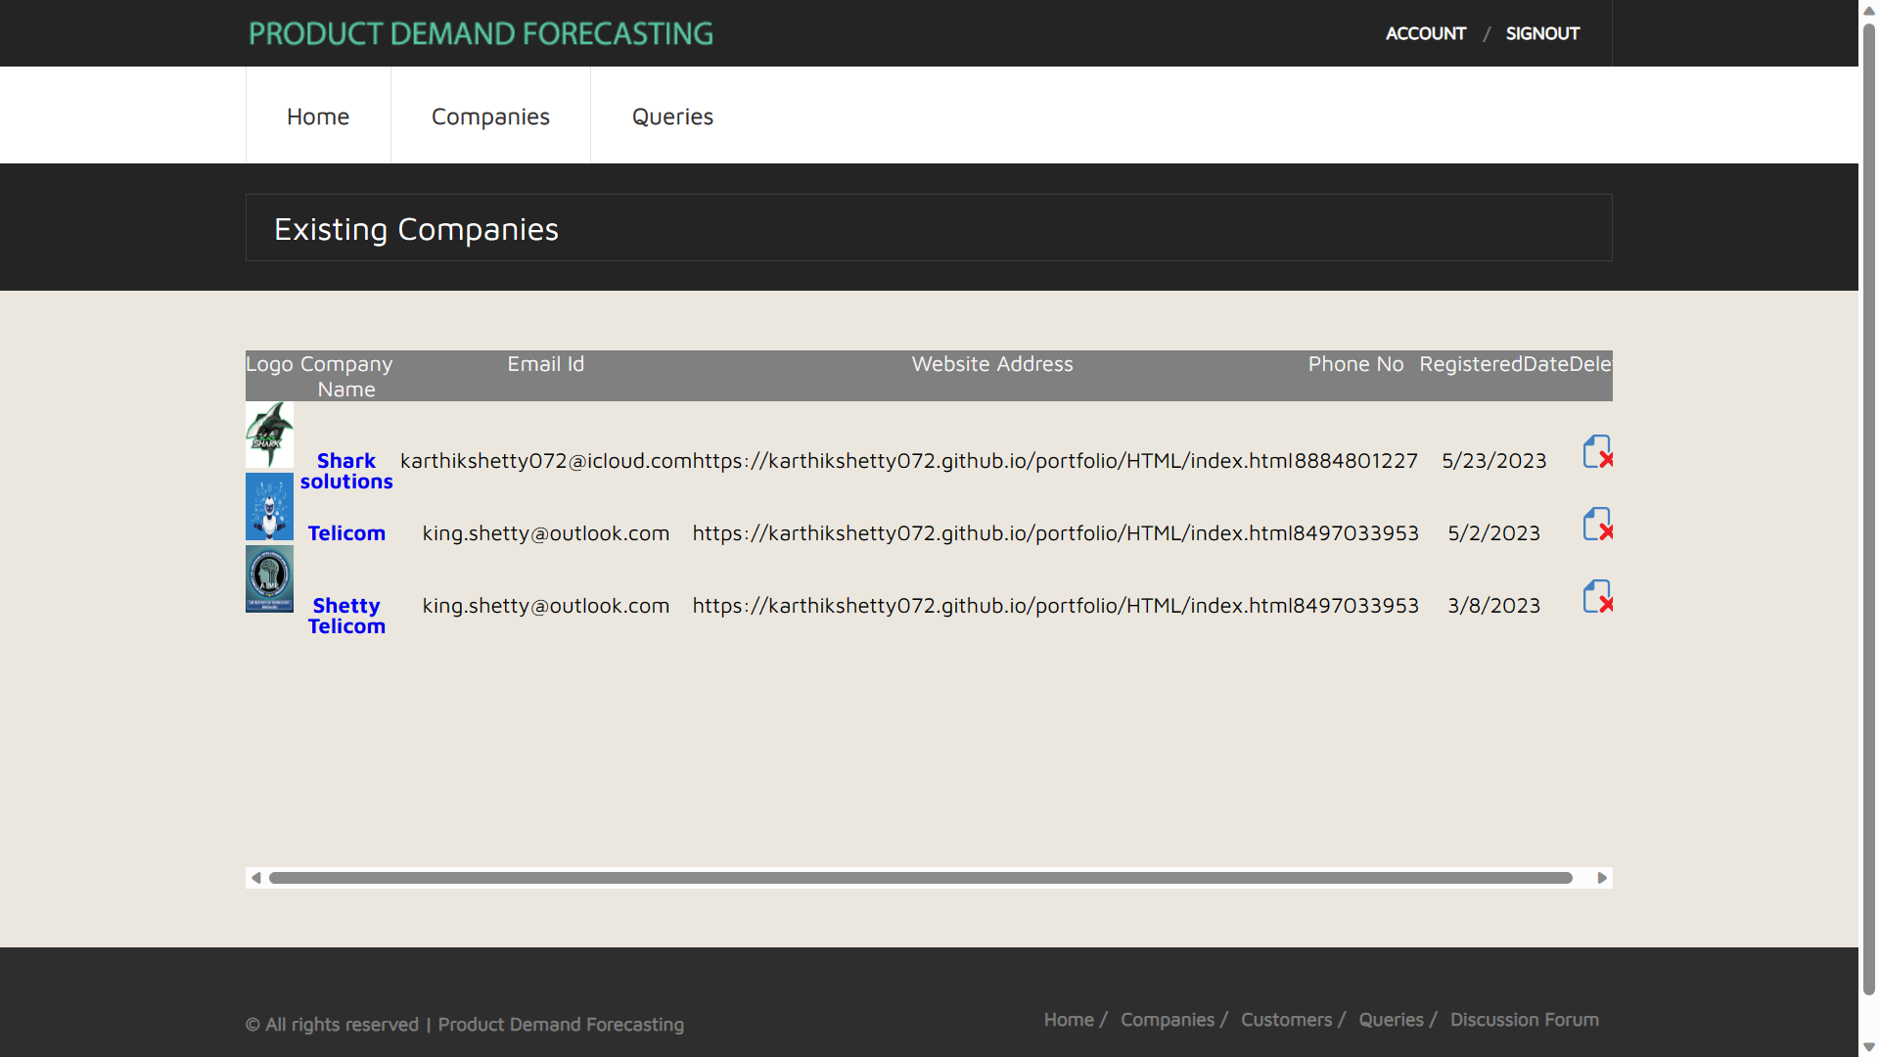
SNAPSHOT
Fig.: The registered companies

Slide 24
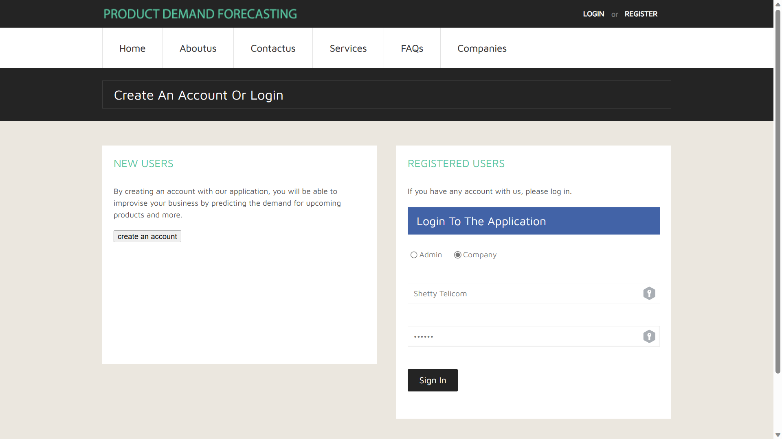
SNAPSHOT
Fig.: Company Login

Slide 25
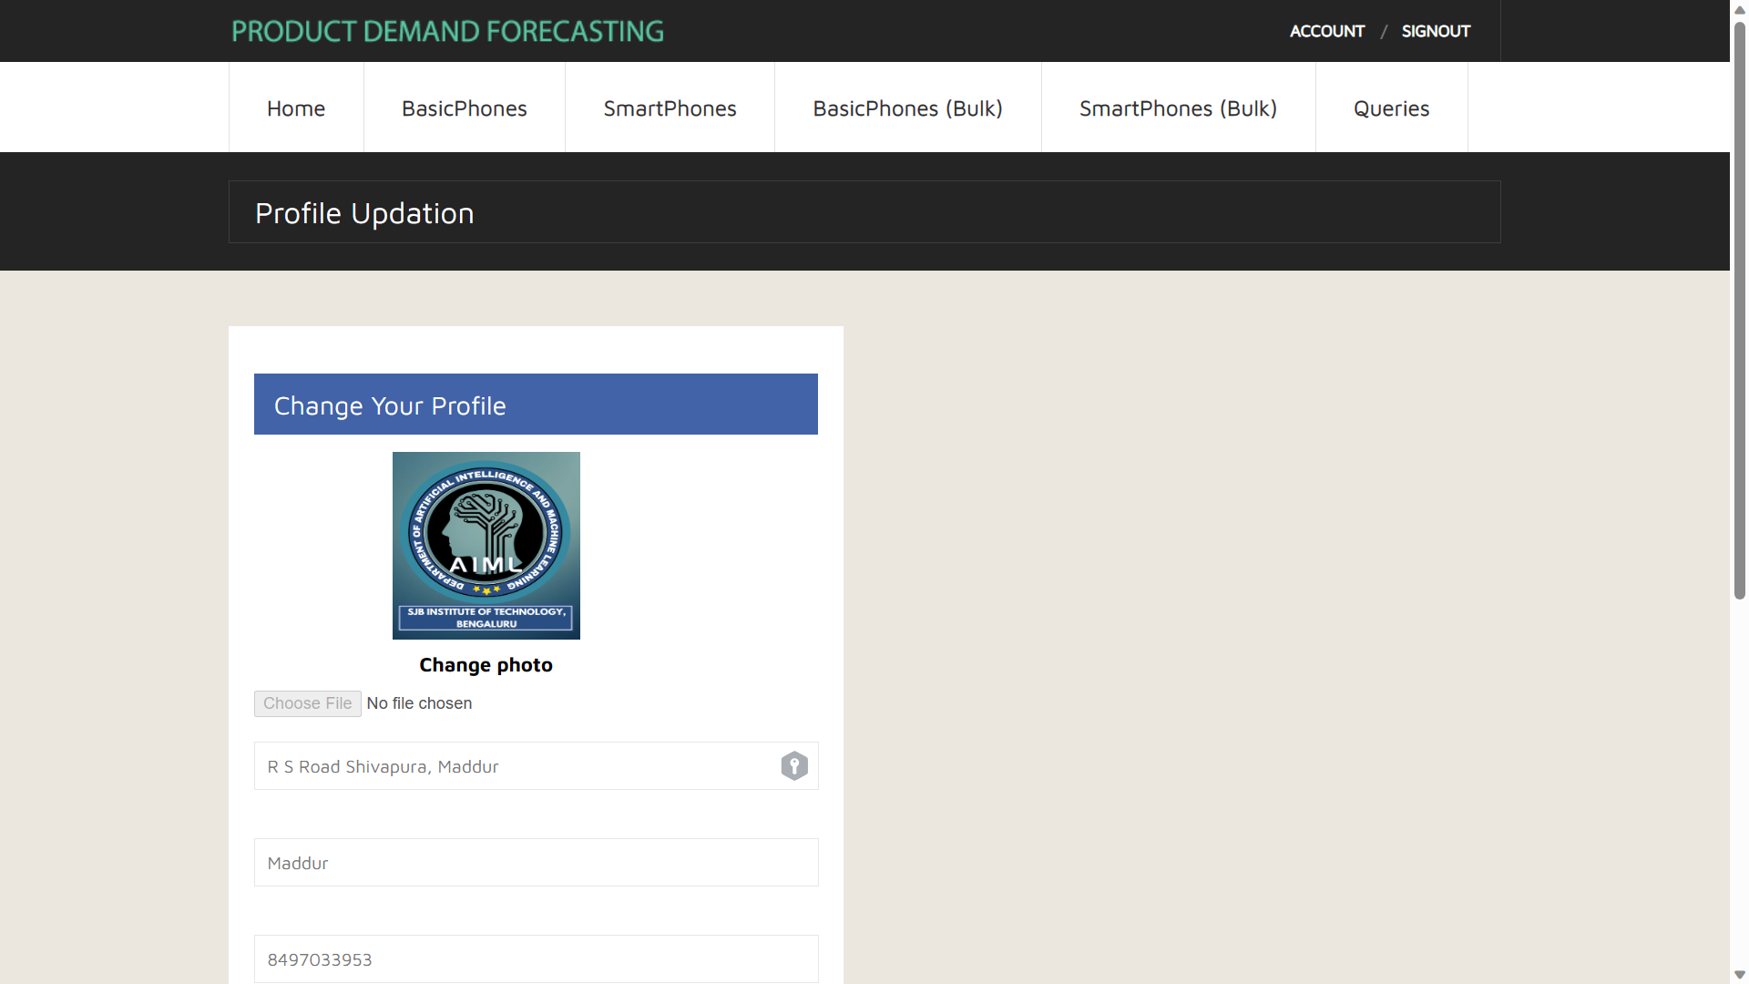
SNAPSHOT
Fig.: Company – Home page

Slide 26
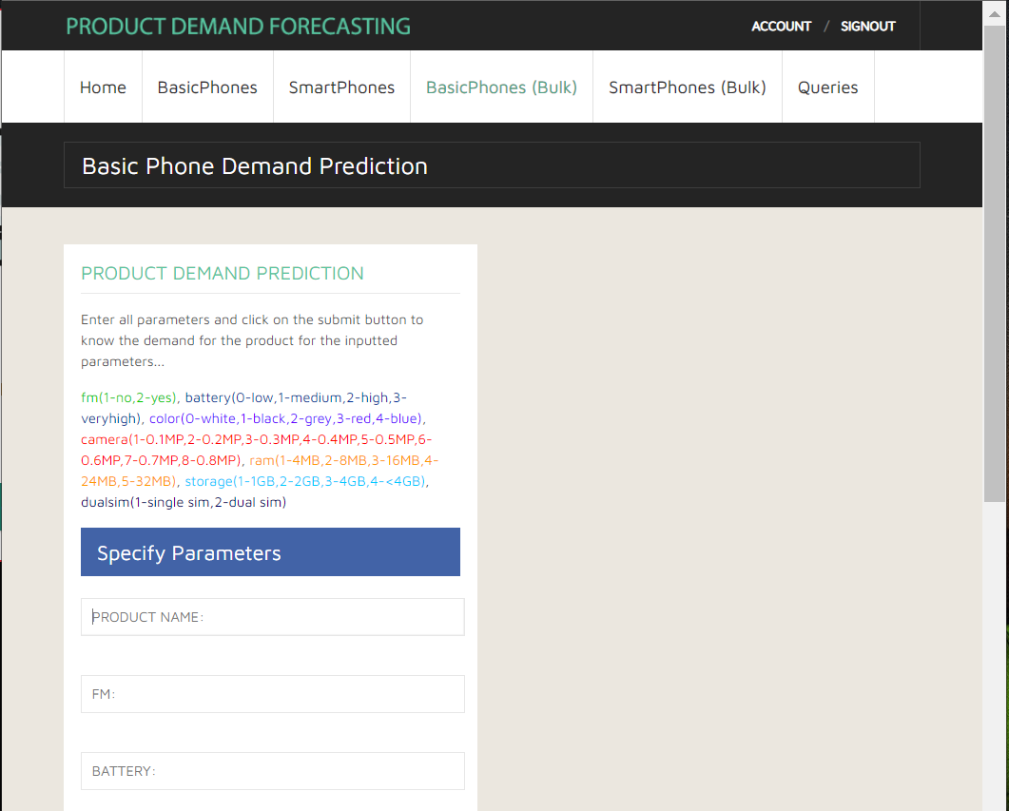
SNAPSHOT
Fig.: Company – Basic Phone Demand Prediction

Slide 27
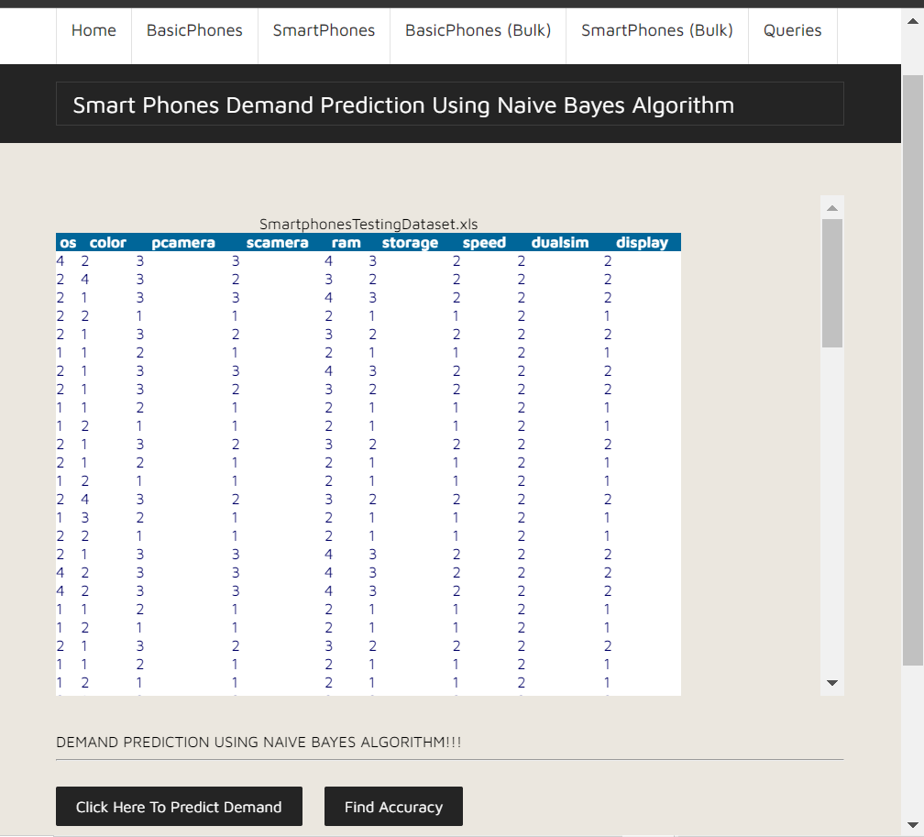
SNAPSHOT
Fig.: Company – Smart Phones(Bulk) Demand Prediction

Slide 28
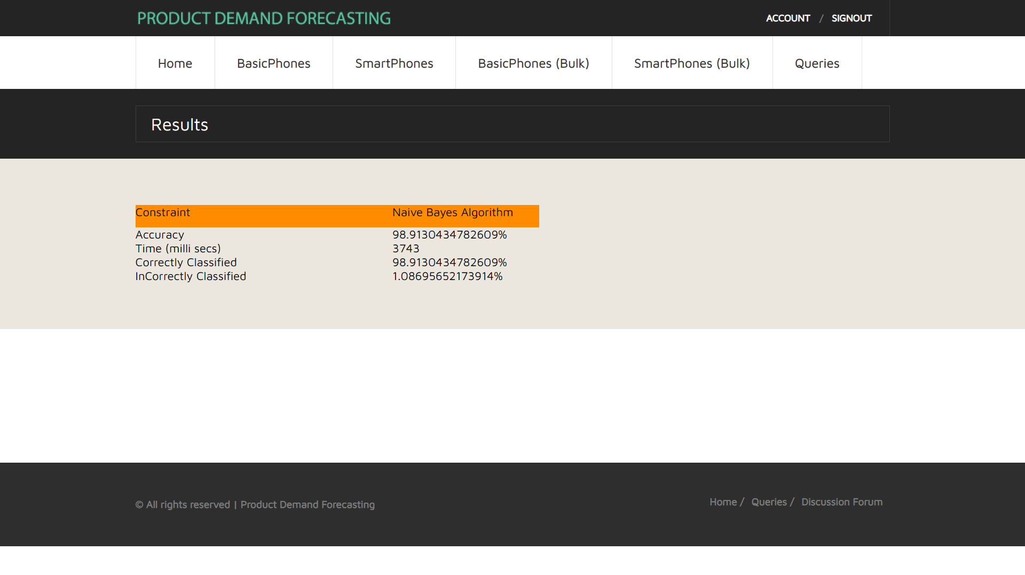
SNAPSHOT
Fig.: Company – accuracy prediction

Slide 29
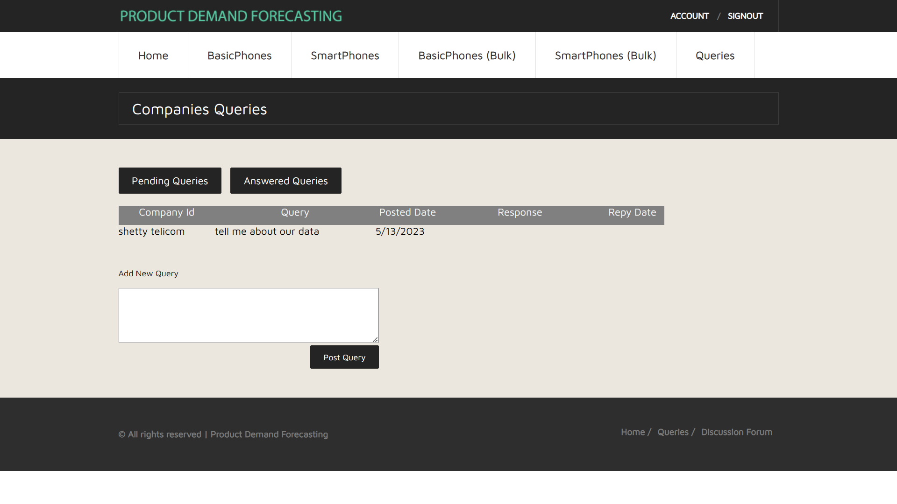
SNAPSHOT
Fig.: Company – any query to the admin

Slide 30

CONCLUSION
The system “Product Demand Forecasting” is in development stage and satisfies all the requirement of the client.
The goals that we are going to achieve by the developing system are:
Simplified and reduced the manual work.
Large volumes of data can be stored.
It provides Smooth workflow.

Slide 31
FUTURE WORK
We can add up the SMS module as a future enhancement to the application, where the companies receives an SMS alert for any notifications such as registration approval, rejection.
We can add the visitor query module as a future enhancement to the application,
where the website visitor can send queries to the administrator of the website.
We can add the customer as an actor to the application, where customer rates the new products, based on the customer ratings, company can decide the product manufacturing.

Slide 32



